Slide 1
Operating Systems
Introduction to Operating System (OS)
A. Frank - P. Weisberg

Slide 2
Slides Credits for all PPTs of OS course
The slides/diagrams in this course are an adaptation, combination, and enhancement of material from the following resources and persons:
Slides of A. Silberschatz, P. B. Galvin and G. Gagne (see book references ahead) with some enhancements by Y. Wiseman.
Slides of Mario Marchand of the University of Ottawa and Patricia Roy of Manatee Community College based on W. Stallings (see book reference ahead) with some enhancements by O. Kremien and E. Gruengard.
Some diagrams from R. A. Finkel and Andrew S. Tanenbaum (see book references ahead).
A. Frank - P. Weisberg

Slide 3
Initial Objectives
To describe the basic organization of computer systems and operating systems.
To give an overview of the many types of computing environments.
To explore varied types of operating systems.
To provide a grand tour of the major components of operating systems.
To describe the services an operating system provides to users, processes, and other systems.
To discuss the various ways of structuring an operating system.
A. Frank - P. Weisberg

Slide 4
What is an Operating System (1)?
A modern computer consists of:
  One or more processors
  Main memory
  Disks
  Printers
  Various input/output devices.
Managing all these varied components requires a layer of software – the
Operating System (OS).
A. Frank - P. Weisberg

Slide 5
What is an Operating System (2)?
An Operating System is a program that acts as an intermediary/interface between a user of a computer and the computer hardware.
OS goals:
  Control/execute user/application programs.
  Make the computer system convenient to use.
  Ease the solving of user problems.
  Use the computer hardware in an efficient manner.
A. Frank - P. Weisberg

Slide 6
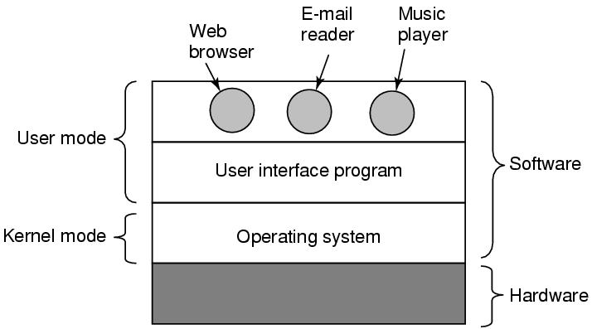
Where does the OS fit in?
A. Frank - P. Weisberg

Slide 7
Services provided by an OS
Facilities for program creation
  editors, compilers, linkers, debuggers, etc.
Program execution
  loading in memory, I/O and file initialization.
Access to I/O and files
  deals with the specifics of I/O and file formats.
System access
  resolves conflicts for resource contention.
  protection in access to resources and data.
A. Frank - P. Weisberg

Slide 8
Why are Operating Systems Important?
Important to understand and know how to correctly use when writing user applications.
Large and complex systems that have a high economic impact and result in interesting problems of management.
Few actually involved in OS design and implementation but nevertheless many general techniques to be learned and applied.
Combines concepts from many other areas of Computer Science: Architecture, Languages,
Data Structures, Algorithms, etc.
A. Frank - P. Weisberg

Slide 9
Course Syllabus (1)
Motivation for Operating Systems (OS)
Introduction
  What's an Operating System?
  Computer/Operating System Overview
  Evolution of Operating Systems
  Functional/Protection Aspects
  Operating System Structures
A. Frank - P. Weisberg

Slide 10
Course Syllabus (2)
Concurrent Processes
  Process Models and Management
  Process Description and Control
  Task/Thread Description and Control
  Concurrency: Mutual Exclusion and Synchronization
  Concurrency: Deadlock and Starvation
A. Frank - P. Weisberg

Slide 11
Course Syllabus (3)
Memory Management
  Real Memory Management
  Motivation for Virtual Memory (VM)
  Paging and Segmentation
  Page Fetch, Placement and Replacement
A. Frank - P. Weisberg

Slide 12
Course Syllabus (4)
Uniprocessor Scheduling
  Levels of CPU Scheduling
  Process Scheduling
External Storage Management
  File Systems/Management
  Directories
  File Allocation
  Disk Scheduling
A. Frank - P. Weisberg

Slide 13
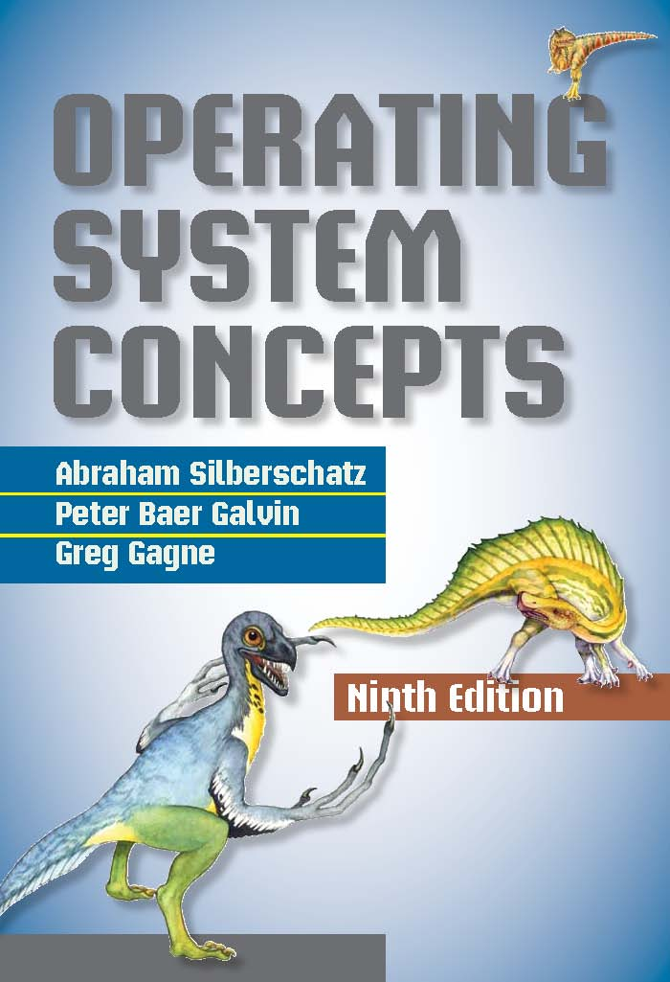
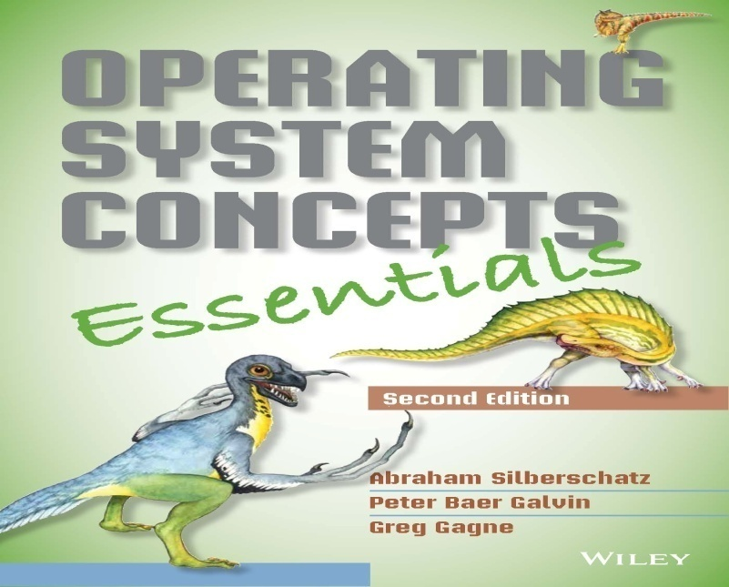
Main Bibliography
A. Silberschatz, P. B. Galvin, and G. Gagne, “Operating Systems Concepts (Essentials)”,
9th Edition, John Wiley & Sons, 2012.
http://codex.cs.yale.edu/avi/os-book/
A. Frank - P. Weisberg

Slide 14
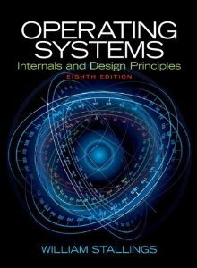
Main Bibliography
W. Stallings, “Operating Systems: Internals and Design Principles”, 8th ed, Pearson, 2015. http://williamstallings.com/OperatingSystems/
A. Frank - P. Weisberg

Slide 15
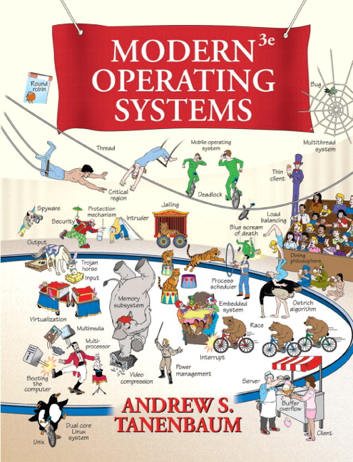
Main Bibliography
A. S. Tanenbaum, “Modern Operating Systems”, 4th ed, Pearson, 2015.
http://www.pearsonhighered.com/educator/academic/product/0,,0136006639,00%2ben-USS_01DBC.html
A. Frank - P. Weisberg

Slide 16
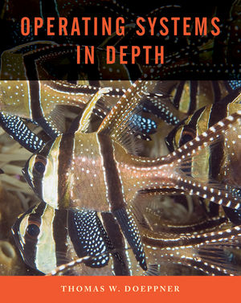
Main Bibliography
T. W. Doeppner, Operating Systems in Depth, John Wiley & Sons, 2011, http://eu.wiley.com/WileyCDA/WileyTitle/productCd-EHEP001803.html
A. Frank - P. Weisberg

Slide 17

Computer Hardware Organization
A. Frank - P. Weisberg

Slide 18
Computer System Components
Hardware – provides basic computing resources (CPU, Memory, I/O devices, Communication).
Operating System – controls and coordinates
use of the hardware among various application programs for various users.
System & Application Programs – ways in which the system resources are used to solve computing problems of the users (Word processors, Compilers, Web browsers, Database systems, Video games).
Users – (People, Machines, other computers).
A. Frank - P. Weisberg

Slide 19
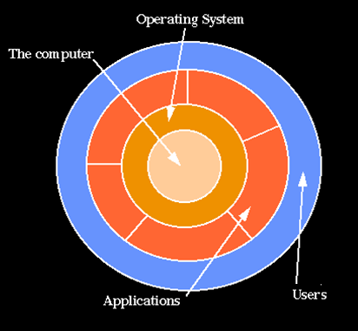
Hierarchical view of computer system
A. Frank - P. Weisberg

Slide 20

Static View of System Components
A. Frank - P. Weisberg

Slide 21
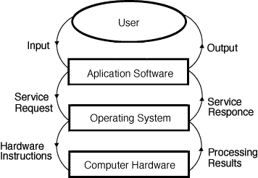
Dynamic View of System Components
A. Frank - P. Weisberg

Slide 22




Layers of a Computer System
End
User
Programmer
Application
Programs
Utilities
Operating-
System
Designer
Operating-System
Computer Hardware
A. Frank - P. Weisberg

Slide 23
What Operating Systems Do
Depends on the point of view.
Users want convenience, ease of use and good performance
  Don’t care about resource utilization.
But a shared computer such as mainframe or minicomputer must keep all users happy.
Users of dedicate systems such as workstations have dedicated resources but frequently use shared resources from servers.
Handheld computers are resource poor, optimized for usability and battery life.
Some computers have little or no user interface, such as embedded computers in devices and automobiles.
A. Frank - P. Weisberg

Slide 24
Views of an Operating System
There are three classical views (in literature):
  Resource Manager – manages and allocates resources.
  Control program – controls the execution of user programs and operations of I/O devices.
  Command Executer – Provides an environment for running user commands.
But one more modern view: the Operating System as a Virtual Machine.
A. Frank - P. Weisberg

Slide 25
1. Resource Manager
Resource Manager:
  Manages and protects multiple computer resources: CPU, Processes, Internal/External memory, Tasks, Applications, Users, Communication channels, etc…
  Handles and allocates resources to multiple users or multiple programs running at the same time and space (e.g., processor time, memory, I/O devices).
  Decides between conflicting requests for efficient and fair resource use (e.g., maximize throughput, minimize response time).
Sort of a bottom-up view.
A. Frank - P. Weisberg

Slide 26
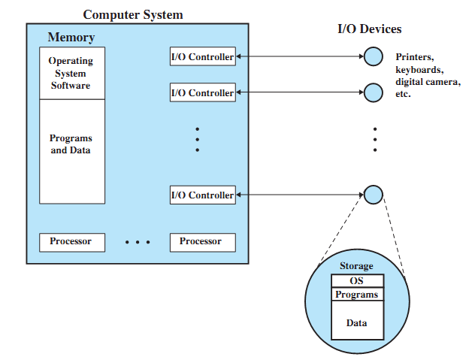
OS as a Resource Manager
A. Frank - P. Weisberg

Slide 27
Resource Manager oriented OS names
DEC RSX – Resource Sharing eXecutive
MIT Multics – MULTiplexed Information and Computing Services
IBM MFT/MVT – Multiple Fixed/Variable Tasks
IBM MVS – Multiple Virtual Storage
DEC VMS – Virtual Memory System
MVS TSO – Time Sharing Option
CTSS – Compatible Time Sharing System
IBM VM – Virtual machine
A. Frank - P. Weisberg

Slide 28
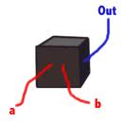
2. Control Program
Control Program:
  Manages all the components of a complex computer system in an integrated manner.
  Controls the execution of user programs and I/O devices to prevent errors and improper use of computer resources.
  Looks over and protects the computer: Monitor, Supervisor, Executive, Controller, Master, Coordinator ….
Sort of a black box view.
A. Frank - P. Weisberg

Slide 29
Control program oriented OS names
Unisys MCP – Master Control Program
DR CP/M – Control Program/Microcomputer
IBM VM/CP – VM Control Program
IBM AIX – Advanced Interactive eXecutive
DEC RSX – Resource Sharing eXecutive
A. Frank - P. Weisberg

Slide 30
3. Command Executer
Command Executer:
  Interfaces between the users and machine.
  Supplies services/utilities to users.
  Provides the users with a convenient CLI (Command Language Interface), also called a Shell (in UNIX), for entering the user commands.
Sort of a top-down view.
A. Frank - P. Weisberg

Slide 31
Command Executer oriented OS names
IBM AIX – Advanced Interactive Executive
IBM VM/CMS – Conversational monitor System
A. Frank - P. Weisberg

Slide 32
Modern view: Virtual Machine (1)
Operating System as a Virtual Machine:
  An interface between the user and hardware that hides the details of the hardware (e.g., I/O).
  Constructs higher-level (virtual) resources out of lower-level (physical) resources (e.g., files).
  Definition: OS is a collection of software enhancements, executed on the bare hardware, culminating in a high-level virtual machine that serves as an advanced programming environment.
    virtual machine = software enhancement = extended machine = abstract machine = layer = level = ring.
A. Frank - P. Weisberg

Slide 33
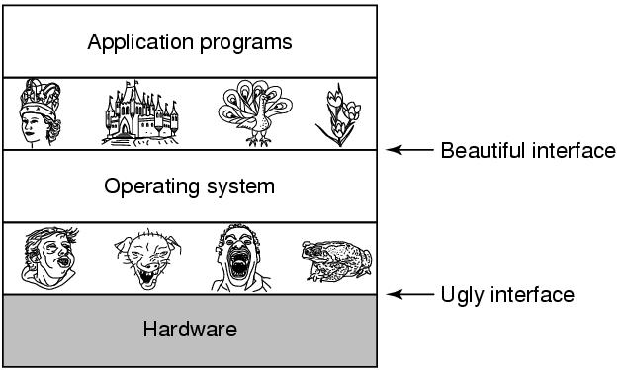
Modern view: Virtual Machine (2)
A. Frank - P. Weisberg

Slide 34
Definition of Operating System
There is no universally accepted definition.
“Everything a vendor ships when you order an operating system” is good approximation but varies widely.
“The one program running at all times on the computer” is the Kernel.
Everything else is either a system program (ships with the operating system) or an application program.
A. Frank - P. Weisberg

Slide 35
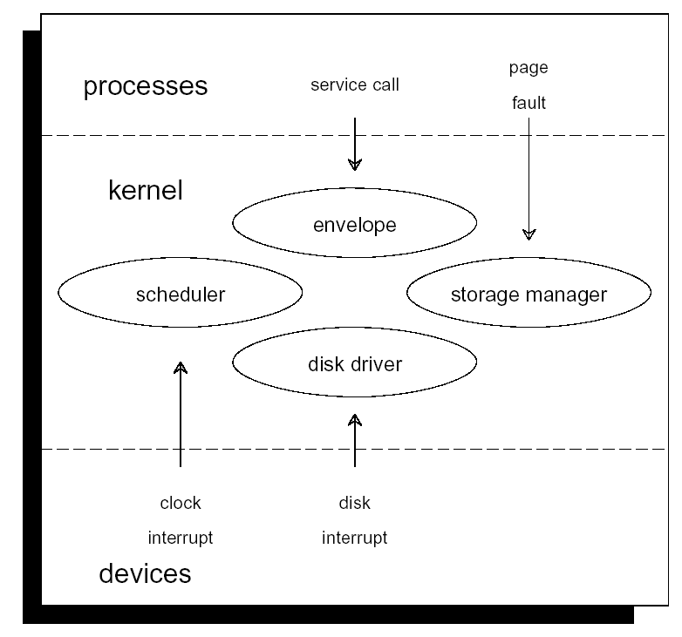
One Kernel Point of View
A. Frank - P. Weisberg

Slide 36
What is the OS/Kernel?
Is the Operating System just the Kernel (not the utilities and application programs)?!
The Command Line Interface (CLI) (or command layer/interpreter or shell) allows direct command entry by the user.
The shell used to be in the kernel but now is a (first between equals) utility outside of it:
  Easy to change/debug
  Many of them (sh, bsh, csh, ksh, tcsh, wsh, bash)
  Possible to switch between them (chsh)
A. Frank - P. Weisberg

Slide 37
UNIX Shell and Utilities
User
Utilities
Shell
Kernel
Hardware
A. Frank - P. Weisberg

Slide 38
CLI is the User OS Interface
CLI allows direct command entry:
  Sometimes implemented in kernel, sometimes by systems program.
  Sometimes multiple flavors implemented – shells.
  Primarily fetches a command from user and executes it.
  Sometimes commands built-in, sometimes just names of programs; if the latter, adding new features doesn’t require shell modification.
A. Frank - P. Weisberg

Slide 39


Bourne Shell (bsh)
A. Frank - P. Weisberg

Slide 40
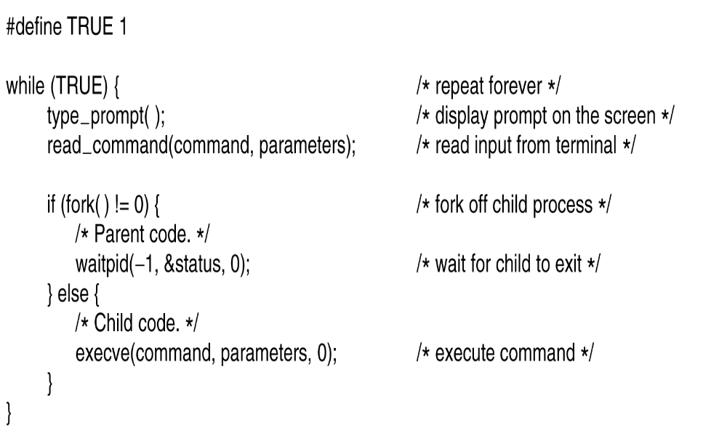
A very simplified Shell
A. Frank - P. Weisberg

Slide 41
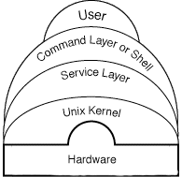
UNIX System Layout
A. Frank - P. Weisberg

Slide 42
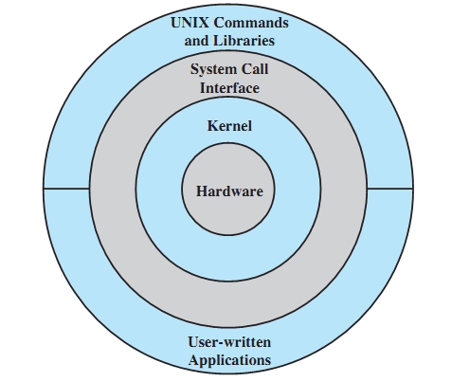
General UNIX Architecture (1)
A. Frank - P. Weisberg

Slide 43
General UNIX Architecture (2)
Other application programs
nroff
sh
who
cpp
a.out
Kernel
date
comp
cc
Hardware
as
we
ld
grep
vi
ed
Other application programs
A. Frank - P. Weisberg

